Slide 1
Business Process Engineering
Sobia.Iftikhar@nu.edu.pk Week 03

Slide 2
Business-to-Business Processes
The business motivation behind interacting business processes stems from value systems, which represent collaborations between the value chains of multiple companies.
These high-level collaborations are realized by interacting business processes, each of which is run by one company in a business to business process scenario.

Slide 3
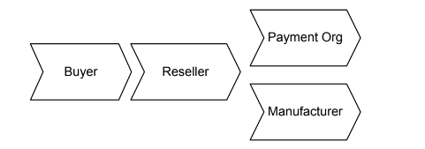
Business-to-Business Processes
A buyer orders goods from a reseller, who acts as an intermediary.
The reseller sends a respective product request to a manufacturer, who delivers to product to the buyer. In addition, the reseller asks a payment organization to take care of the billing.

Slide 4
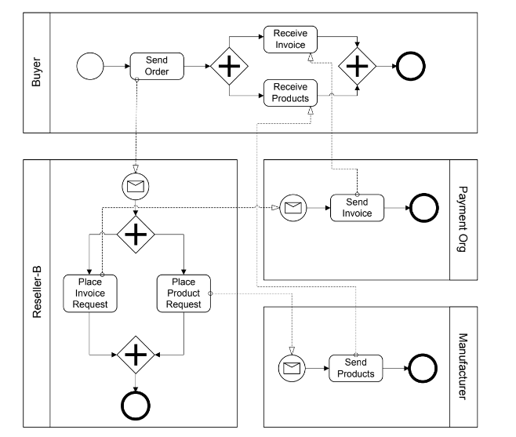
Example of business-to-business collaboration through interacting busi- ness processes

Slide 5
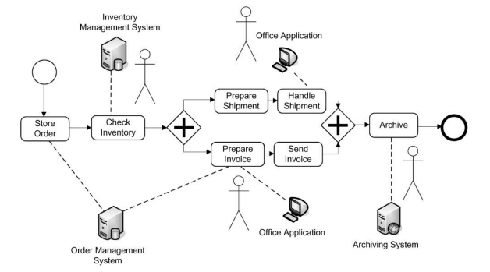
Business-to-Business Processes
Workflows in which humans are actively involved and interact with information systems are called human interaction workflows.

Slide 6
Business-to-Business Processes
Enterprise Services Computing
A service captures functionality with a business value that is ready to be used.
Services are made available by service providers.
A service requires a service description that can be accessed and understood by potential service requestors.
Software services are services that are realized by software systems.
Consider a real-world service, for example, one to fix a car. The service the garage provides needs to be specified in a way that the customer can find and use. Once the car is fixed, the customer pays the bill and the service is completed.

Slide 7
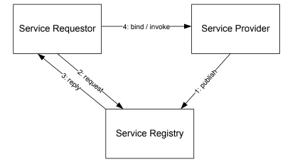
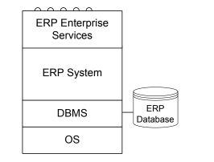
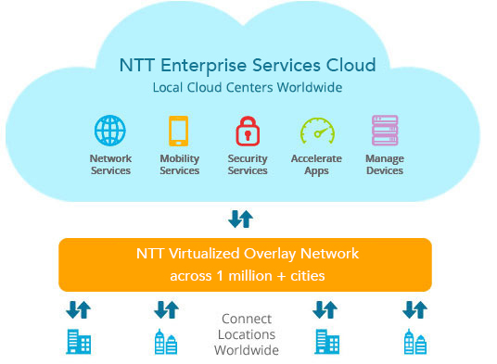
Business-to-Business Processes
Enterprise Services Computing
Service Oriented Architecture
Enterprise Services
functionality of application systems can be described and provided by services.

Slide 8
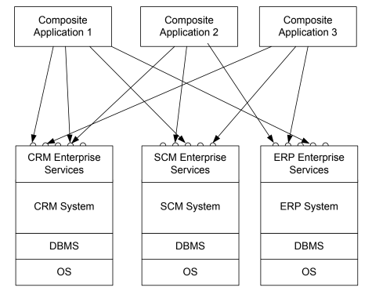
Business-to-Business Processes
Composite Application
With this background in enterprise services architectures, an intra-company
scenario is sketched, where new applications should be built on top of an existing customer relationship management system, a supply chain management system, and an enterprise resource planning system. These systems expose enterprise services via standardized interfaces. The applications built on top are known as composite applications,

Slide 9
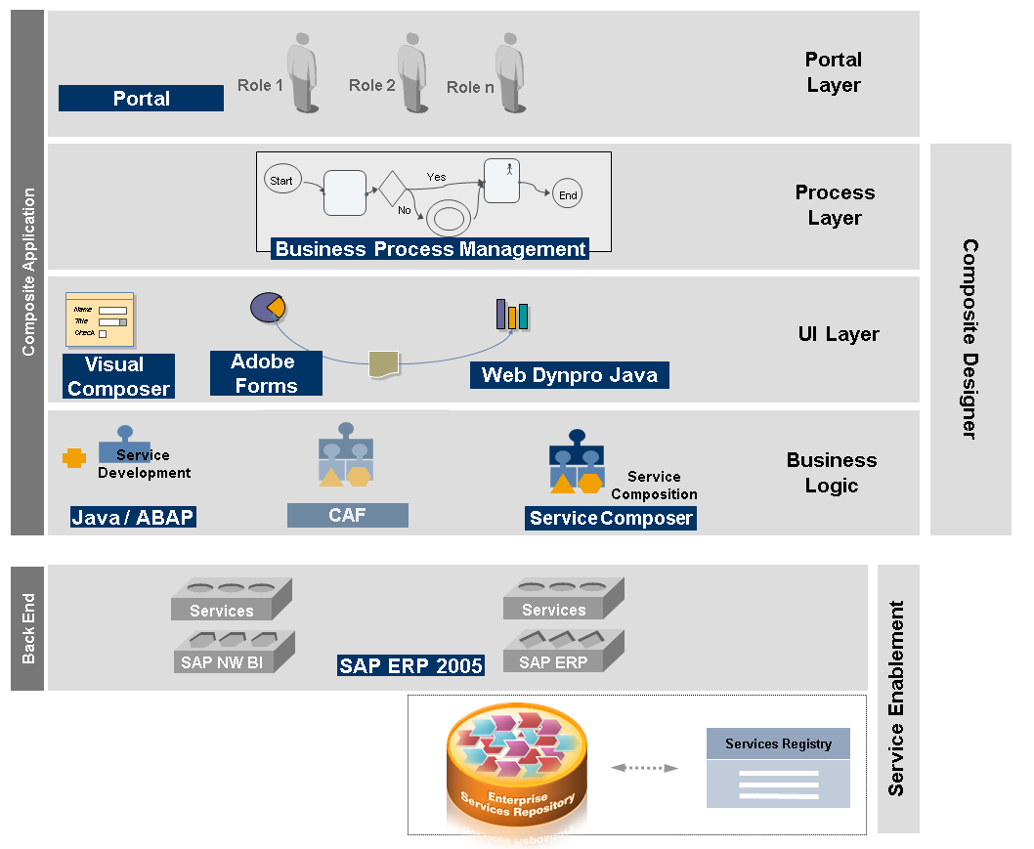

Slide 10
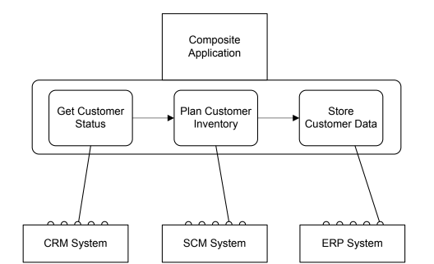
Service Composition
Using service composition to realize composite applications

Slide 11
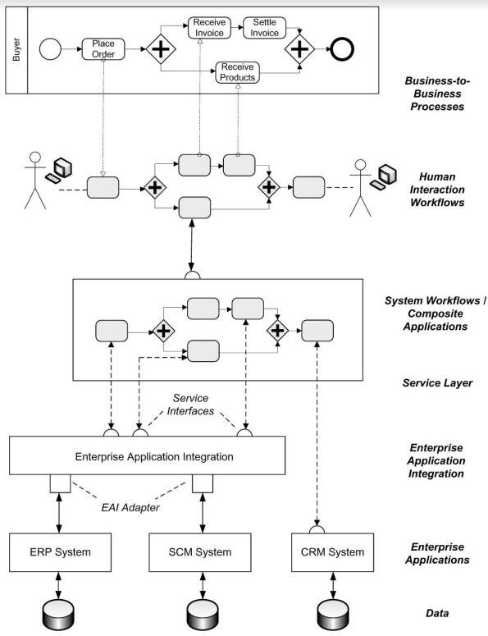
Business process management landscape
Workflow Management Coalition defines workflows and workflow management
systems as follows.

Slide 12
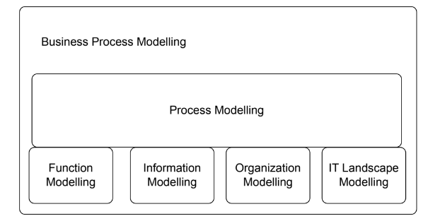
Business Process Modeling
Function modelling, data modelling, organization modelling, and modelling of the operational information technology landscape are required to
provide a complete picture of a business process.

Slide 13
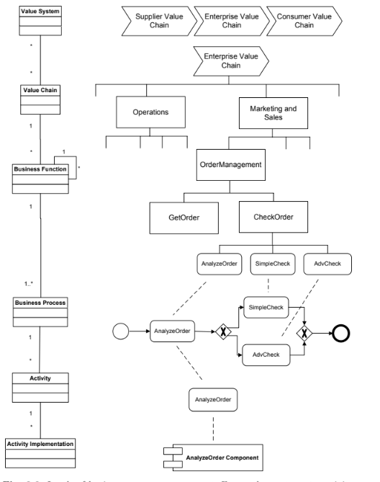
Activity Models and Activity Instances

